Slide 1
SMART ROOM

Slide 2



About our project model
RESEARCH
ABSTRACT
DESIGN
We based our research on reducing global warming while implementing the covid protocols.
We believe people need more products specifically dedicated to this niche market
Minimalist and easy to use

Slide 3
what our project does…..
Our project is a portable motion and climate detector which can calculate the number of people present in the room along with sensing the extra data about the indoor space.

Slide 4
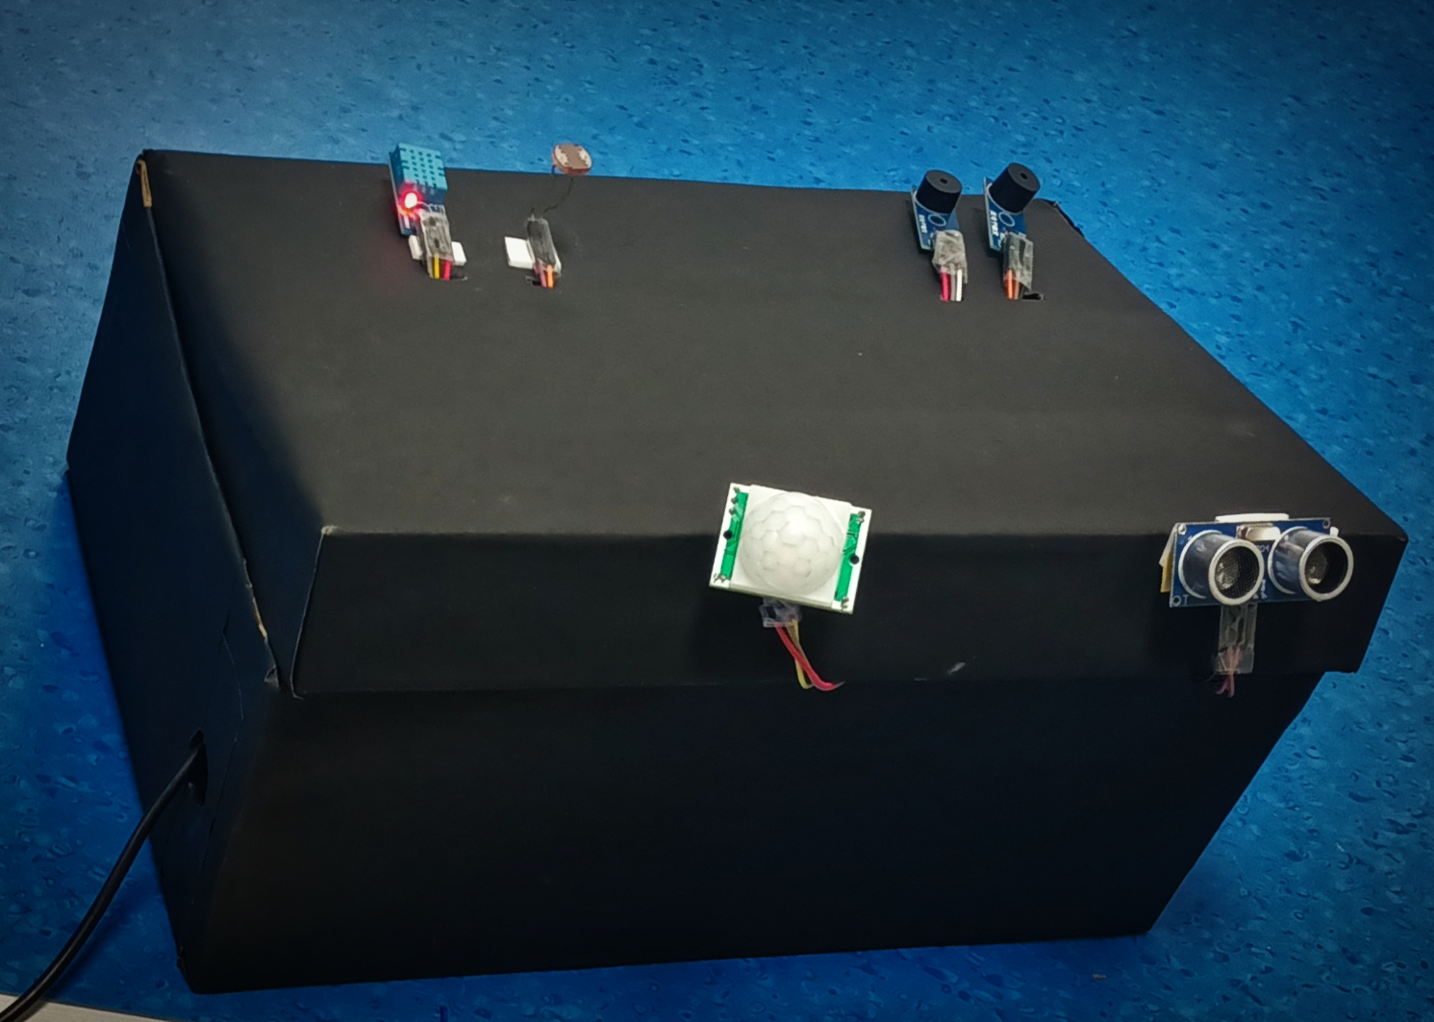
Components used
Pir motion sensor
Ultrasonic sensor
LDR sensor
DHT11 sensor
2 buzzers
Jumper wires
Breadboard
ESP32

Slide 5

Often in public spaces and professional environments,
when a room is left unoccupied, the climate control and
lighting systems are left on which leads to a wastage
of electricity

Slide 6

The chief objective of our project was to build an inexpensive
and reliable IoT system that would warn the last user to switch
off the air conditioning and lights. Which would eventually
help in reducing global warming.

Slide 7
APPLICATIONS
Due to the versatile and general design of our project, it is possible to deploy it in a multitude of different applications with minimal changes including, but not limited to:-
Dangerous work environments or isolated laboratories
Home security systems
Offices and workspaces
Automatic thermostat system

Slide 8
OVERVIEW

Slide 9
FUNCTIONAL OVERVIEW OF OUR PROJECT
People detection by motion sensor
Door open/close detection by ultrasonic
Temperature detection using DHT sensor
Light detection using LDR.
Alarm when utilities are being used in an inefficient manner.
Data collected uploaded to om2m and thing speak.

Slide 10
Working principle
The ultrasonic sensor detects when the door is opened or closed
The pir sensor is used to detect the direction of movement of the person by detecting if there is motion inside the room
The data from both sensors is combined to increment or decrement the global counter of the number of occupants in the room
When the count is zero, we check if the lights and air conditioning are turned off, and if not, we sound the buzzer to remind the person leaving last to turn them off
When the room occupancy is more than the threshold value, then the second buzzer will be turned on

Slide 11
PROJECT
DEMONSTRATION

Slide 12
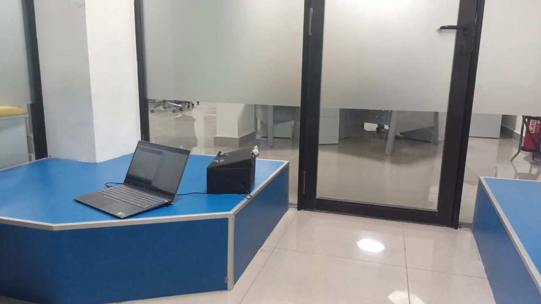

Slide 13
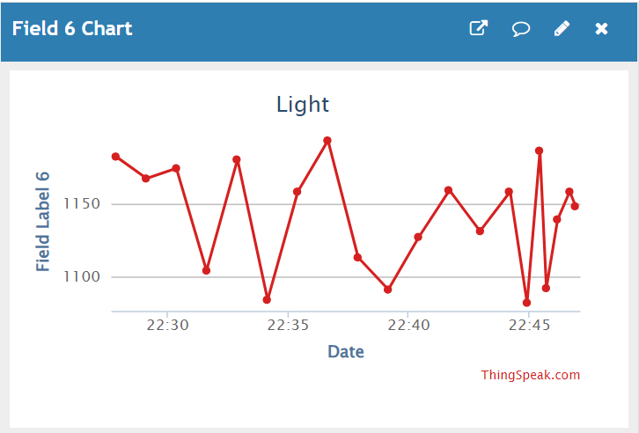
As a secondary goal, we take the data collected by the temperature and light sensors and store it on the cloud to be processed for analytics later.
Data collection

Slide 14
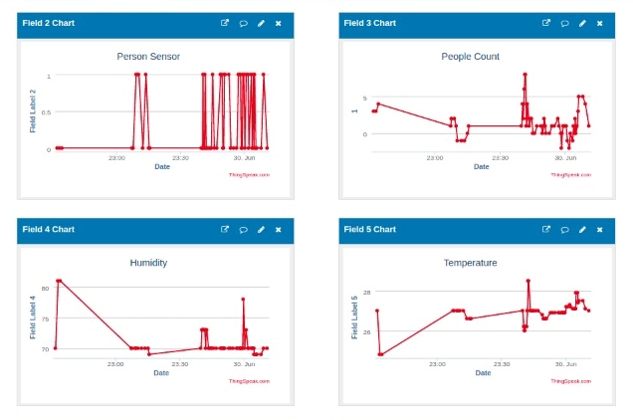

Slide 15
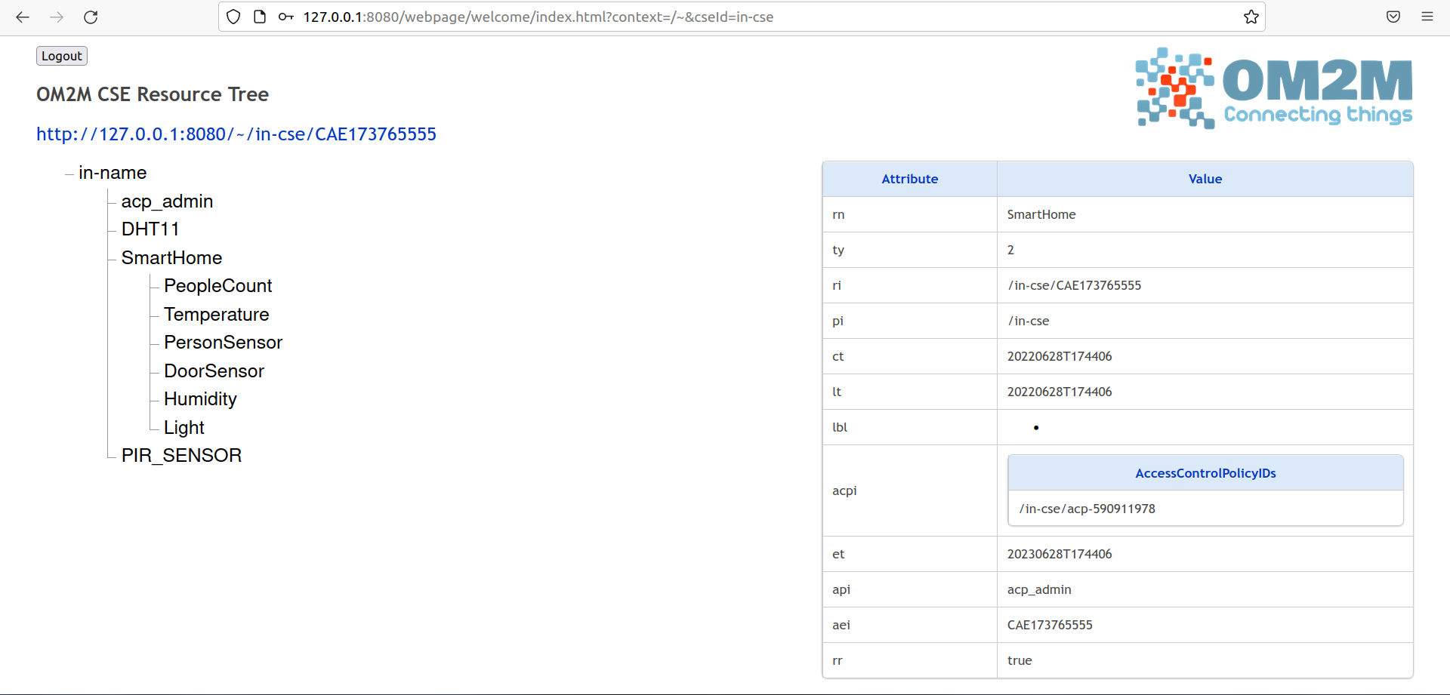

Slide 16
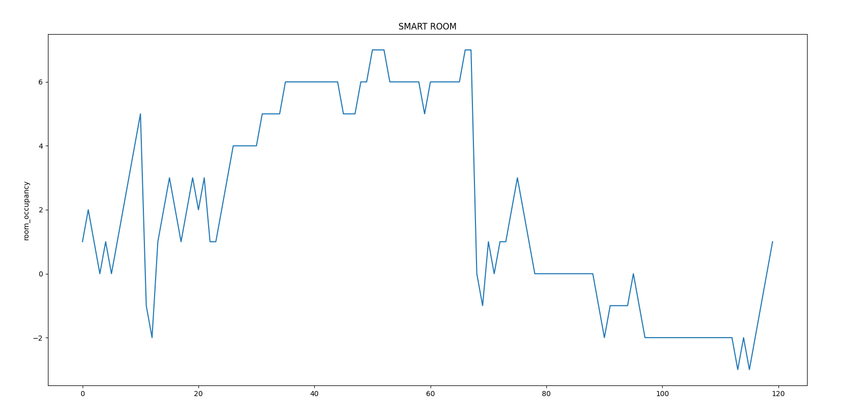

Slide 17
DATA ANALYTICS
Our project is capable of collecting large amounts of data about any indoor space it is deployed, thus not only is it useful as an active IoT device, but it is also convenient to deploy as a passive data collection unit.
Potential applications are:-
Mapping out room usage frequency for an entire building
Real-time space management and efficient resource allocation
Mapping the climate of an indoor space to the number of occupants
Pandemic preventative programs

Slide 18
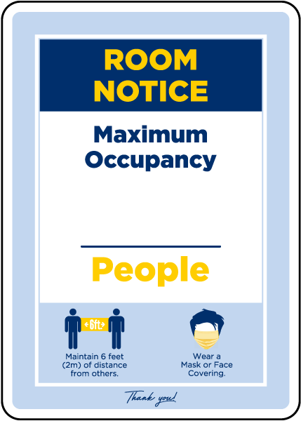
Our project offers a convenient way to limit the number of people present in an enclosed space and monitor the temperature. Needless to say, this is extremely useful for dealing with endemics and pandemics like covid-19 and monkeypox

Slide 19
Why is our device better?
The products available on the market are either PIR or Ultrasonic or Dual Technology based. Whereas, we use a combi of PIR and Ultrasonic to minimize the errors as much as possible.
The cost of our device would be around $10 which is far more cheaper than the present market products that cost around $100.
The utilization of occupancy sensors helps reduce electricity and running costs to a great extent. Rising demand for energy-efficient sensing solutions to keep the building occupants comfortable and safe is the major factor boosting the occupancy sensor market growth.

Slide 20
THANK YOU

